Slide 1

Digital Twin-Enabled Service Satisfaction
Enhancement in Edge Computing
INFOCOM 2023
知行合一、经世致用
自强不息 厚德载物
自强不息 厚德载物
Tsinghua University of China
Central South University

Slide 2
I. INTRODUCTION
I. Digital twins --- background
Digital twins mirror the statuses of physical objects via continuous monitoring, along with implementing comprehensive and high-fidelity digital models for physical objects in the virtual world.
II. Mobile Edge Computing --- application scenarios
Digital twins that are deployed in traditional clouds usually demand real-time data and statuses of their physical objects for timely processing and analysis. The long communication delay between physical devices and the remote cloud results in system performance degrading significantly. The Mobile Edge Computing (MEC) paradigm has been envisioned as a revolutionary solution to provide computing resource in the proximity of users to curtail the communication delay.
III. Service Satisfaction --- optimal object
The user satisfaction on digital twin-enabled query services relies on the freshness of digital twin data, which is measured by the Age of Information (AoI).
知行合一、经世致用
自强不息 厚德载物
自强不息 厚德载物
Tsinghua University of China
Central South University

Slide 3
I. INTRODUCTION
IV. digital twin placement scheme --- refer algorithm
1) static --- deploy digital twins at the beginning
It is desirable that the network service provider can obtain the mobility information of physical objects and the user query request arrivals before the time horizon, by adopting the machine learning-based prediction mechanism
2) dynamic --- challenging to deploy digital twins in cloudlets
V. contributions --- novelty
1) a new metric to measure user satisfactions on AoI-aware query service provisioning in MEC empowered by digital twins
2) two novel utility maximization problems(service satisfaction)
VI. Experimental --- results
Experimental results demonstrate that the proposed algorithms are promising, and outperform the comparison baseline algorithms, improving by no less than 11.6% of the performance, compared to that of the baseline algorithms.
知行合一、经世致用
自强不息 厚德载物
自强不息 厚德载物
Tsinghua University of China
Central South University

Slide 4
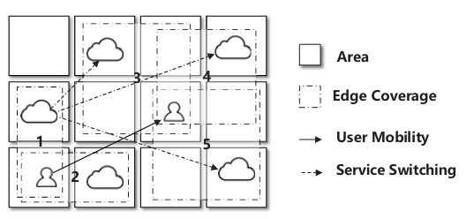
II. RELATED WORK
A. The mobility issue in MEC --- Without digital twin
B. The Age of Information (AoI) in MEC --- Without digital twin
C. The mobility-aware service provisioning in MEC --- Without AoI
In this paper we investigate the
mobility-aware query service provisioning
based on digital twin data in MEC
知行合一、经世致用
自强不息 厚德载物
自强不息 厚德载物
Tsinghua University of China
Central South University

Slide 5
III. MODEL
I. System model
Access Points
cloudlet
remote cloud
V₁
optical fiber cable
negligible delay
v₀
gateway
d_{v,v0} (large delay)
v₀
transmission delay d_{e}
V₂
v₁
v₀
synchronization a_{m}(data size) every δ_{m}(time)
remote digital twin
m
c_{m}
instantiation delay
d_{m}^{ins}
physical objects
local digital twin
知行合一、经世致用
自强不息 厚德载物
自强不息 厚德载物
Tsinghua University of China
Central South University

Slide 6
III. MODEL
II. AoI at digital twins --- based on data synchronization and digital twin instantiation
Assuming the current time slot is t, the data at a digital twin is based on the update of its object generated at time slot t′. The Age of Information (AoI) at the digital twin is defined as (t − t′).
Access Points
cloudlet
v₀
gateway
d_{v,v0} (large delay)
V₁
v₀
remote cloud
synchronization a_{m}(data size) every δ_{m}(time)
m
c_{m}
instantiation delay
d_{m}^{ins}
0
physical objects
local digital twin
a_{m} * d_{v,v0} + d_{m}^{ins}
知行合一、经世致用
自强不息 厚德载物
自强不息 厚德载物
Tsinghua University of China
Central South University

Slide 7
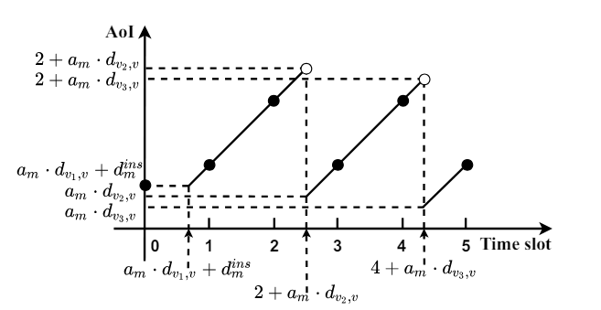
III. MODEL
II. AoI at digital twins --- example
For example, let the time horizon be T = {0, 1, 2, 3, 4, 5}, and the object m sends its updated data with size am to its digital twins every 2 time slots, i.e, at time slots 0, 2, 4, respectively. Object m is located at AP v1 initially, then moves to AP v₂ and v₃ at time 2 and 4, respectively.
digital instantiated
time
知行合一、经世致用
自强不息 厚德载物
自强不息 厚德载物
Tsinghua University of China
Central South University

Slide 8

III. MODEL
III. utility gain --- final optimal object
1) AoI of a query result --- consider AoI of digital twins and delay of query
2) utility gain --- between query remote and query cloudlt
V₁
v
₀
remote cloud
W_{q,v0}
v₀
m_{q}
s_{q} · d_{vq,locq}
W_{q,vq}
V_{q}
v_{q}
cloudlet
w_{mq,vq,tq}
Access Points
知行合一、经世致用
自强不息 厚德载物
自强不息 厚德载物
Tsinghua University of China
Central South University

Slide 9
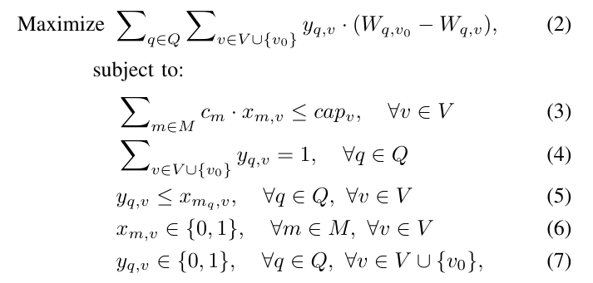
IV. ALGORITHM
A. static digital twin placement scheme
1) Integer Linear Programming(ILP) solution --- traditional, max optimal, slow
We show the NP-hardness of the problem through a reduction from a well-known NP-hard problem - the knapsack problem, a equivalent to the special case of the static utility maximization problem. The static utility maximization problem is NP-hard, because the knapsack problem is NP-hard. It has ILP solution
知行合一、经世致用
自强不息 厚德载物
自强不息 厚德载物
Tsinghua University of China
Central South University

Slide 10



IV. ALGORITHM
A. static digital twin placement scheme
2) performance guaranteed approximation algorithm --- paper refer, suboptimal, faster
i. submodular function --- utility gain is a submodular function
submodular function define:
Maximizing a monotone nonnegative submodular function with cardinality constraint, A greedy algorithm to achieve at least​ below, (1 - 1/e) approximately 0.63.
ii. maximization goal ---- marginal utility gain
increment utility gain divide computing resource consumption
知行合一、经世致用
自强不息 厚德载物
自强不息 厚德载物
Tsinghua University of China
Central South University

Slide 11
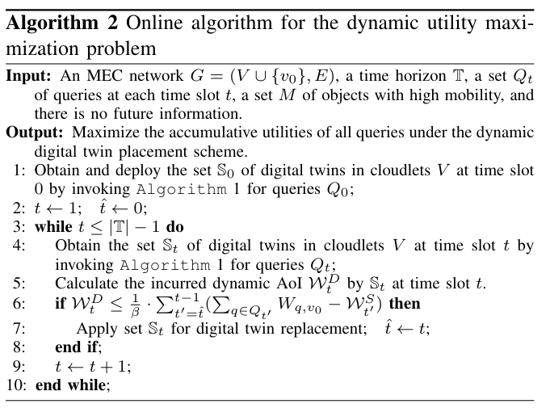
IV. ALGORITHM
B. dynamic digital twin placement scheme
知行合一、经世致用
自强不息 厚德载物
自强不息 厚德载物
Tsinghua University of China
Central South University

Slide 12
VI. PERFORMANCE EVALUATION
Compare baseline algorithms:
1) Heu.1:
we iteratively identify a digital twin deployment with the largest utility improvement in a cloudlet with sufficient residual computing resource. This procedure ends until no cloudlet can accommodate more digital twins;
2) Heu.2:
we consider the cloudlets one by one randomly. For the first cloudlet, we identify the digital twin deployment in this cloudlet with the largest utility improvement until the cloudlet can accommodate no more digital twins. This procedure ends until all cloudlets are examined;
3) LP:
the Linear Programming solution (2) to the problem, as an upper bound on its optimal solution.
Simulation results demonstrate that the proposed algorithms outperform the comparison baseline algorithms, and the performance improvement is no less than 11.6%, compared with the baseline algorithms.
知行合一、经世致用
自强不息 厚德载物
自强不息 厚德载物
Tsinghua University of China
Central South University

Slide 13
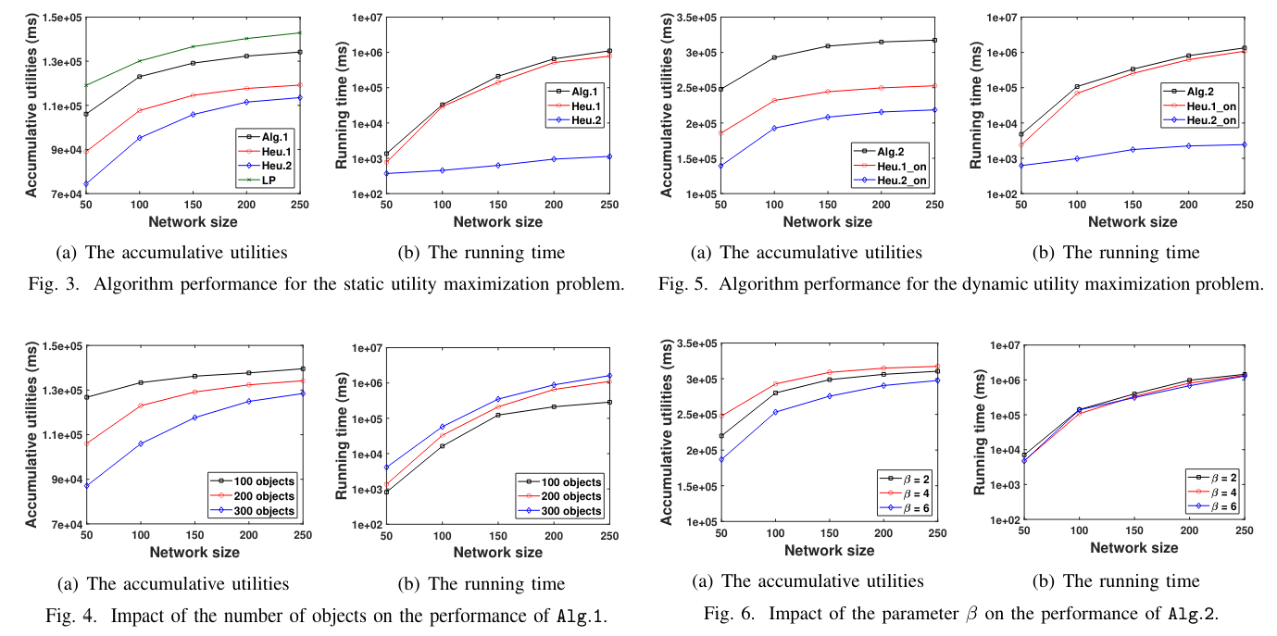
VI. PERFORMANCE EVALUATION
Experimental result
知行合一、经世致用
自强不息 厚德载物
自强不息 厚德载物
Tsinghua University of China
Central South University

